Slide 1



11/10/24
There may be some new G11 helpers, not sure tho.

Slide 2
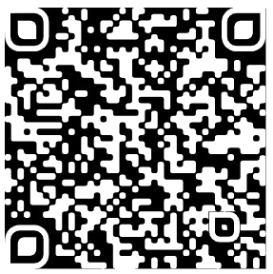
New SYSTEM
Files
Help
Tasks
PowerPoint Presentations
Instructions
Home | IST Computer Club (theistcomputerclub.wixsite.com)
PDFs
Python Applications

Slide 3
New Person
Monday 15:00 – 15:15 [Insert Room Name]
Planning – Task, pdf, PowerPoint
Coding – Tuesday → Thursday
Session - Friday
Someone from Grade 11 may be joining.

Slide 4
As for Today
Go to:
Theistcomputerclub.wixsite.com/the-computer-club
Look at it – Do whatever you want.
What Projects?
https://forms.gle/1BbwFpWM9a3esDMR8
As for today, I don’t want us to code. I want you guys (and the new guy, if any) to familiarise yourselves with the Computer Club Website. You will find everything on there. The ‘This Week page shows what we’ll be doing this week, I update this every week (usually on Monday, as shown before). Then we will decide as to what types of projects we shall do once you are skilled enough.

